Slide 1


THE FEDE: An education INGO
at the service of higher
and vocational schools
https://fede.education/

Slide 2





















Recognition and Partners
Switzerland
European Institutions
International Institutions
Professional Federations
France

Slide 3
495 higher and vocational institutions
Present in 42 countries on 4 continents
A network of more than 300,000 people
12 elite subject areas
170 European degrees
From Foundation Degree to DBA
The FEDE is an INGO, an International Non-Governmental Organisation.
It was founded in 1963 in Geneva and is administered by a committee of 14 elected members.

Slide 4






The Council of Europe since 1987 (participatory status);
The Council of Europe’s Steering Committee for Education (CDEDU) (observer status)
The FEDE: an influential institutional network
The Council of Europe’s Steering Committee for Culture, Heritage and Landscape (CDCPP) (observer status);
Thanks to its expertise,
the FEDE is an official, recognised-status partner
of several international organisations:
The United Nations Educational, Scientific, and Cultural Organisation (UNESCO) (consultative status)
The International Organisation of La Francophonie (OIF) (consultative status)
The United Nations Economic and Social Council (special consultative status)

Slide 5

The FEDE is listed in the European Union Transparency Register and is a member of the European Commission’s Pact for Skills.
It works in partnership with innovative and leading European professional federations in their fields such as:
The European Telecommunications Network Operators (ETNO), The GEOPA COPA.
The FEDE:
a network defending pedagogical innovation in Europe

Slide 6



The FEDE is also committed to fighting corruption (GRECO) in partnership with the Council of Europe’s Group of States against Corruption.
With the GRECO, the FEDE built in 2018-2019 an educational programme focused on the fight against corruption and its legal framework.
From September 2019 to june 2022, nearly 15,000 young learners from the FEDE network had access to this innovative program.
Launched in 2015, the Council of Europe’s Platform on Ethics, Transparency and Integrity in Education (ETINED) is a network of specialists appointed by the Member States of the Council of Europe and aiming to promote discussion on best practice as to transparency and integrity in education.
The FEDE has been invited as an expert to ETINED Platform meetings since 2019. Through its regular participation, it is helping to build a culture of democracy and participation.
Created in November 2020 by a Partial Agreement signed by 17 CoE member states, the Observatory of History Teaching in Europe (OHTE) aims to advocate States on the importance of teaching history in building critical thinking and the fight against fake news.
The FEDE is involved in OHTE activities, striving to help provide learners with the technical, material and conceptual tools they need to exercise vigilance in their pursuit of knowledge and skills.
The FEDE:
a network committed to quality education and the fight
against corruption

Slide 7
The FEDE
a network
that promotes
the collaboration between establishments around the world
Provides access to an international network of more than
300,000 persons
Provides solid pedagogical tools
The Fede encourages international professional mobility thanks to its PEPS program
More than
250 000 alumni
The FEDE: an international network of over 450 member schools

Slide 8

The FEDE: an international network that increases your visibility through a lively website
After membership, a school file is created for each member institution, which will be integrated into
the FEDE website, a lively and dynamic tool.
All our member schools are listed on our website
with their school records and logos.
1000 visitors per week consult the descriptions
of the various listed schools.
The FEDE website receives around 300 daily visits with peaks that can exceed 4000 visitors (January 2022)
https://fede.education/

Slide 9

The FEDE: an international network that increases
your visibility through a federal magazine
The FEDE Mag, a federal magazine three times a year
Interviews with new member schools, educational innovations, job presentations, etc.
Highlights and on the actions carried out by member schools (new partnerships, research publications, humanitarian actions, etc.)
The FEDE Mag is distributed to member schools and institutional partners of the FEDE. It is accessible to everyone on our website

Slide 10
The FEDE: They share their experience with you
in our federal magazine
“You called for a meeting five years ago between the FEDE and
the UET. This led to Albania joining our Federation”.
UET – Dritan TOLA - Albanian Ambassador
Dritan TOLA: ‘’The teaching of democratic values, as supported by the FEDE, aligns with Albanians’ European aspirations. The European project is above all a project for peace; in these difficult times, that needs to be underlined. Our national hero, Skanderbeg, embodies the defense
of freedom and the power of unity; he symbolises
our collective conscience. He represents values common
to both Albanians and Europeans.’’

Slide 11
The FEDE: They share their experience with you
in our federal magazine
Why did you join the FEDE?
LINGUASTAR - Language center in Romania, Cluj-Napoca
LINGUASTAR: ‘’We share the FEDE’s views on subjects such as academic excellence, educational innovation and open-mindedness. Plus, as a FEDE member we can offer
our students new services. We also hope to develop
our educational and institutional network.’’

Slide 12

THE FEDE’s Academic Activities
Monitoring of trades and skills
Expertise with institutional bodies
Doctoral School
  Business teaching guidelines
  European degrees
  Professional Certificates
  Approvals and Accreditations
  Publication of educational and
  research works
  CoE, UNESCO,
  ONU, OIF…

Slide 13

European Degrees
Built around 3 Teaching Units: Professional Expertise, European Culture and Citizenship, European Languages
Degrees are based on the European Credit Transfer System (ECTS).
A “ready to use” pedagogical solution tailored to each school
The FEDE's European degrees repositories are accessible free of charge to member schools
The educational set-up is simple and free of charge. The FEDE teams support each school individually
Access to guidelines, pedagogical resources, examinations and degrees

Slide 14
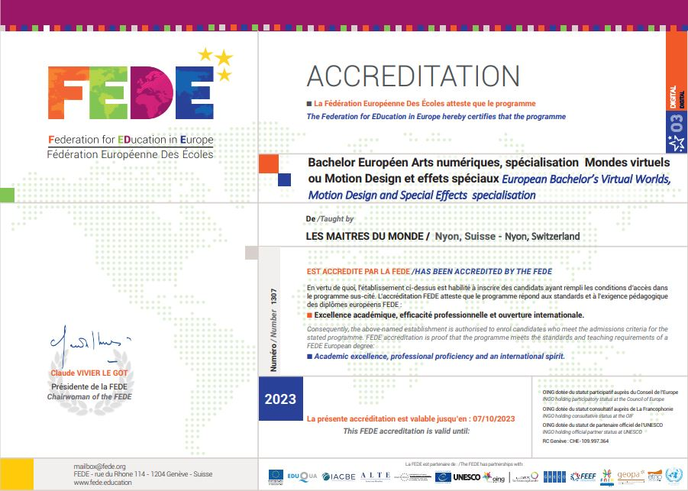
FEDE ACCREDITATION
Create your own tailored European FEDE degree
Accredited degrees enjoy international recognition and visibility
Promote quality education to European values
Carry greater assurances as to graduates’ potential career prospects.
The FEDE awards a degree supplement with ECTS credits
The FEDE awards a European degree

Slide 15
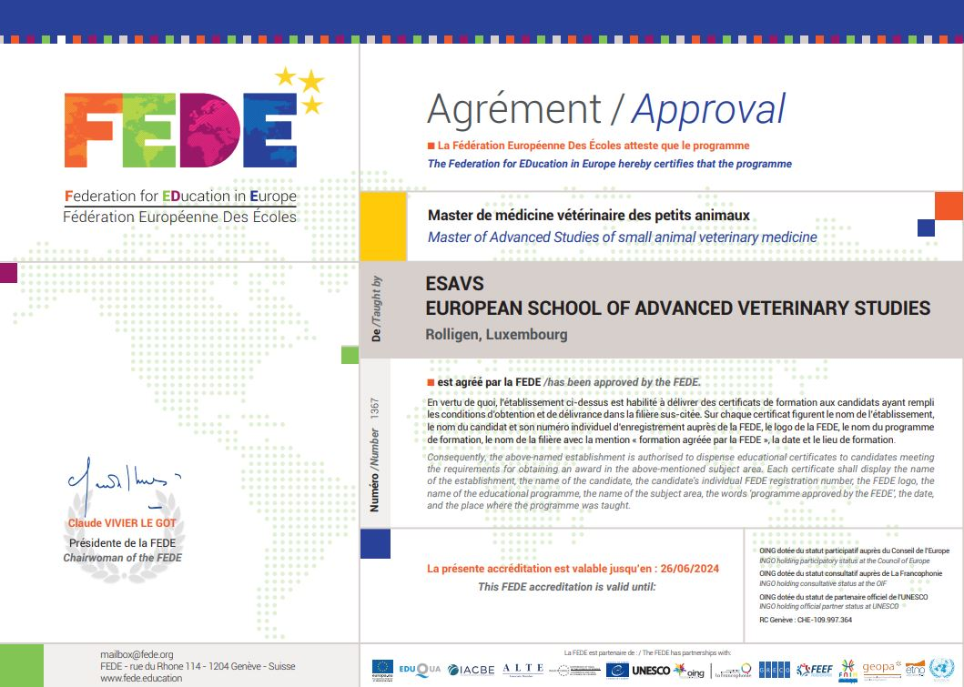
FEDE approval
Certify your degree or your programme
Quality of a programme or qualification offered
by a FEDE member institution
An official ‘seal of approval’ from a supranational body
Recognition of your high-quality educational course

Slide 16

The FEDE LANGUAGE CERTIFICATE
based on the CEFR
Available in 6 languages: German, English, Spanish, French, Italian and Portuguese
Covers the 4 levels of CEFR : A2 / B1 / B2 / C1
Attest of language proficiency in professional situations
A career accelerator that assesses the 4 skills
of comprehension and production, written and oral

Slide 17
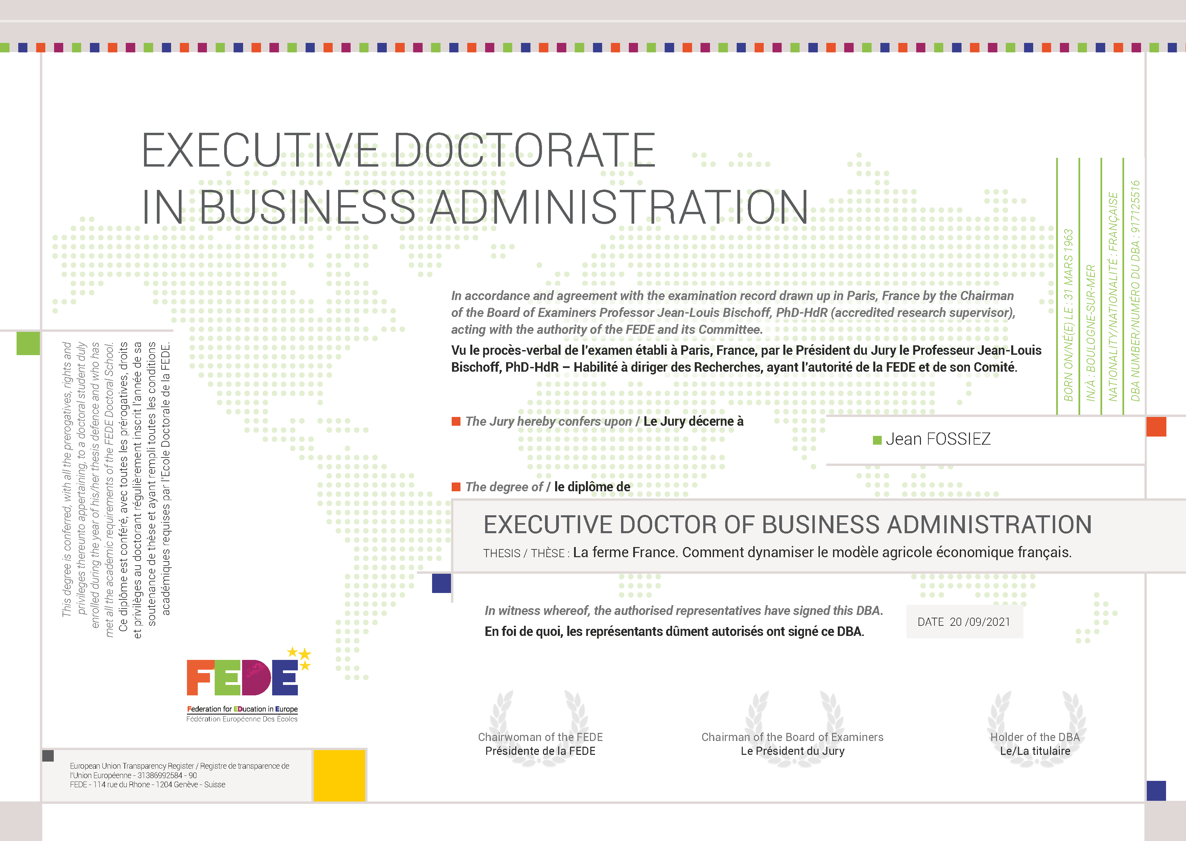
THE FEDE Doctoral school
An opportunity for reflection,
analysis and academic stocktaking
The FEDE Research Institute: a laboratory of ideas, dedicated to the problem of professionalisation
and new professions
Through its doctoral school, the FEDE offers
an applied research programme:
the Executive DBA FEDE
A doctoral programme in three years (on average)
It is aimed at managers, consultants, executives or professional project leaders
In the desire to enhance a career by pursuing research work

Slide 18

FEDE INITIATIVES
The PEPS
(subsidised work experience programme for mobility)
Promotes international mobility of students
from member schools.
Strengthens the skills of all to improve employability in a multicultural environment.
FEDE International Mobility Grants
They shall be granted to:
- FEDE students
- To finance a professional experience abroad
- Internships, humanitarian actions...

Slide 19

Fede initiatives
FEDE HUMAN RIGHTS PRIZE
The FEDE is involved
in citizenship education
From 1 to 14 FEDE Human Rights Excellence Prize are awarded
every year
They highlight the initiatives of FEDE students, faculty and schools
in the field of human rights.
Grants: 150€ to 2000€

Slide 20




FEDE initiatives - SOS Ukraine
The FEDE calls on its member institutions to:
  Host Ukrainian pupils and students.
  They can continue to study in their native language.
  Education is a fundamental right.

Slide 21
FEDE’S KEY FIGURES
33
people
constitute the permanent team
5
offices
Switzerland
(Geneva), France (Paris, Lyon), Spain (Malaga), Morocco (Mohammedia)
495
Institutions
in
42 countries
15%
secondary education
85%
Higher education
4500
FEDE certification graduates
since 2020
19
programmes approved
7000
to
8000
Language certificate
per year
12
Elite subject areas
Foundation Degree, Bachelor’s, Master’s, MBA, DBA
11 284
FEDE candidates in 2021
13 000
Students
2022 forecast
80 034
Assessments
170
FEDE European Degrees
93
Accredited degrees

Slide 22
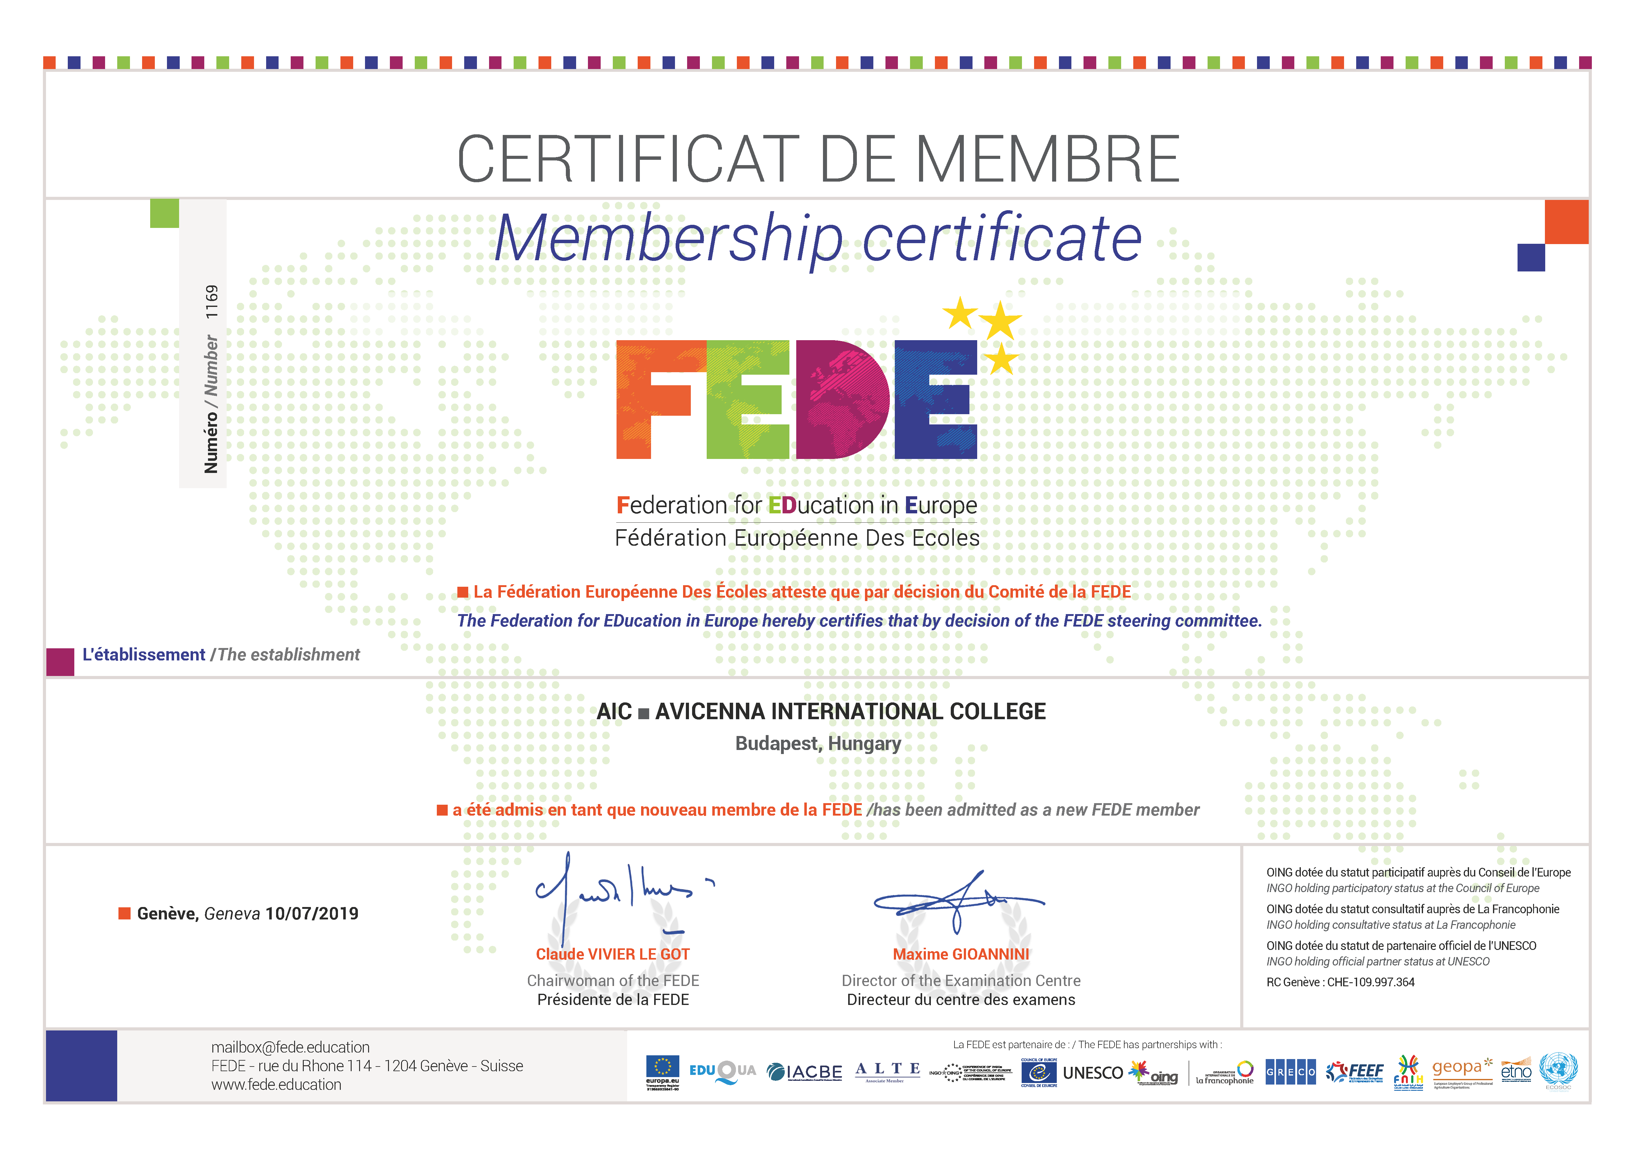
THE FEDE MEMBERSHIP CERTIFICATE

Slide 23
THANK YOU FOR YOUR ATTENTION
Contact: join@fede.org
https://fede.education/

